Slide 1



Your Market, Unlocked

Slide 2


Slide 3
Rival
Purpose
ERD Database Model
Creating Python classes to fill in the ERD
Algorithm
JSON
Spotting differences and signal creation

Slide 4




Rival | Purpose
Core Functionalities
Rival Tracking: Basic profile for your own company and tracked rivals.
Rival Snapshots: Structured snapshots covering basics, organization, hiring focus, and strategy.
Signals: Automatic signals generated when meaningful differences between snapshots are detected.
Signal Refresh: Signals can be refreshed at any time and are automatically updated based on the latest available data.
Rival Profiles: Short AI-generated summaries of the rivals and competitive position.
Dashboard: A single overview screen with your company, rivals, new signals, and recent news.

Slide 5
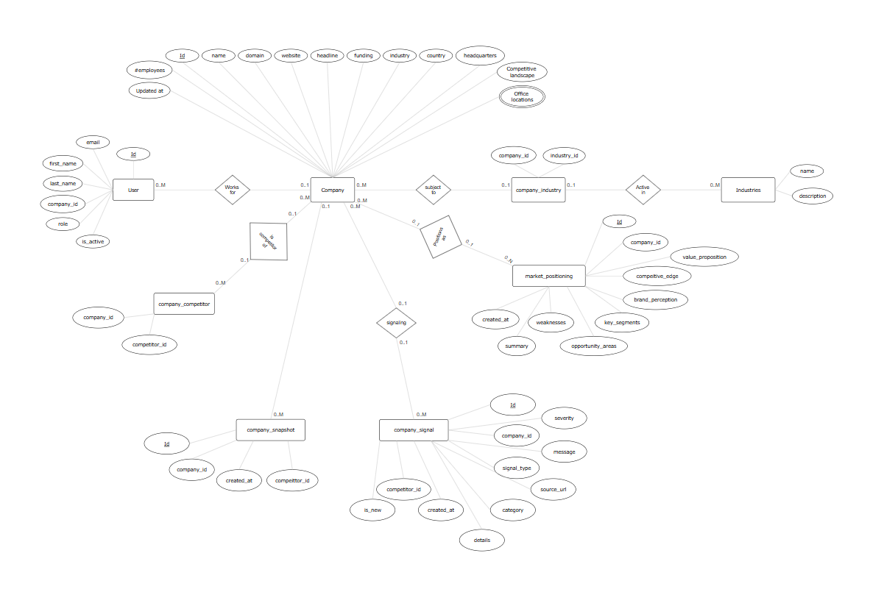
Rival | ERD Database Model
Broad Overview
User
Company
Industry
Signal
Snapshot
Competitor
Market Positioning
Industries

Slide 6
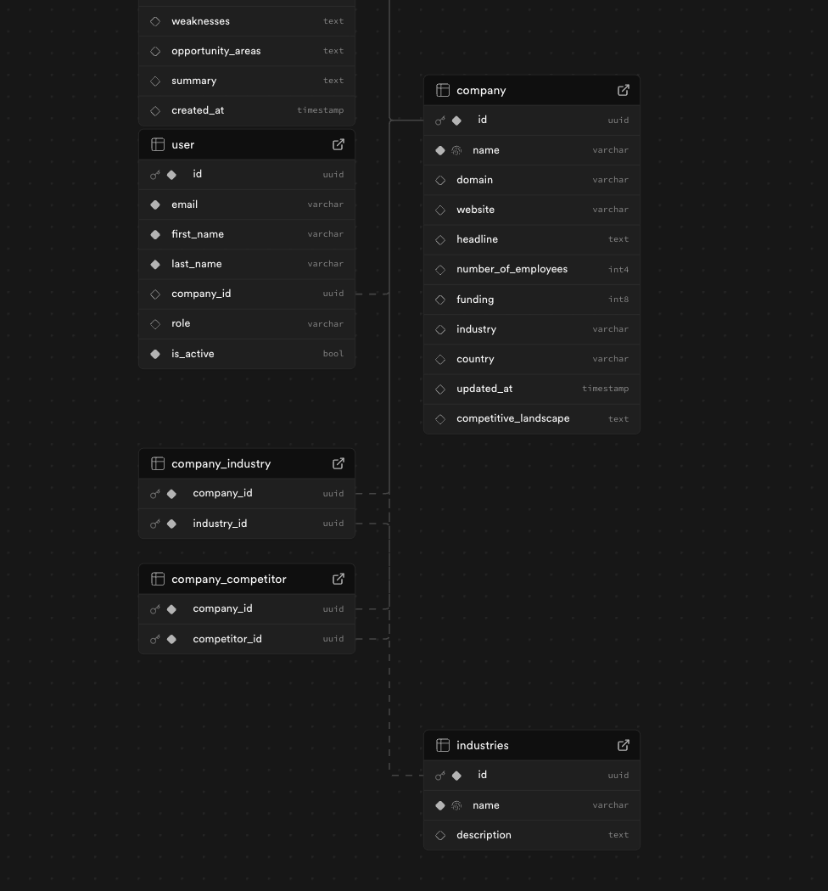
Rival | ERD Database Model
User
Company

Slide 7
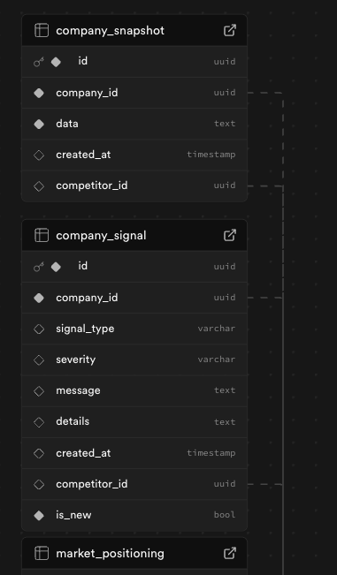
Rival | ERD Database Model
Company Snapshot
Company Signal

Slide 8
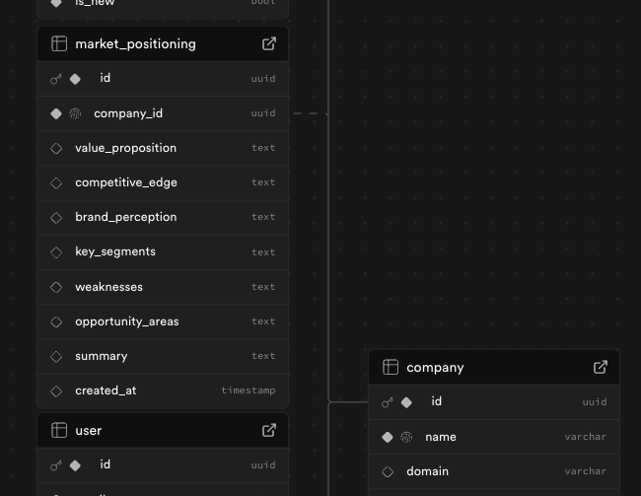
Rival | ERD Database Model
Market Positioning

Slide 9
Rival | ERD Database Model
Company Industry
Company Competitor
Industries

Slide 10
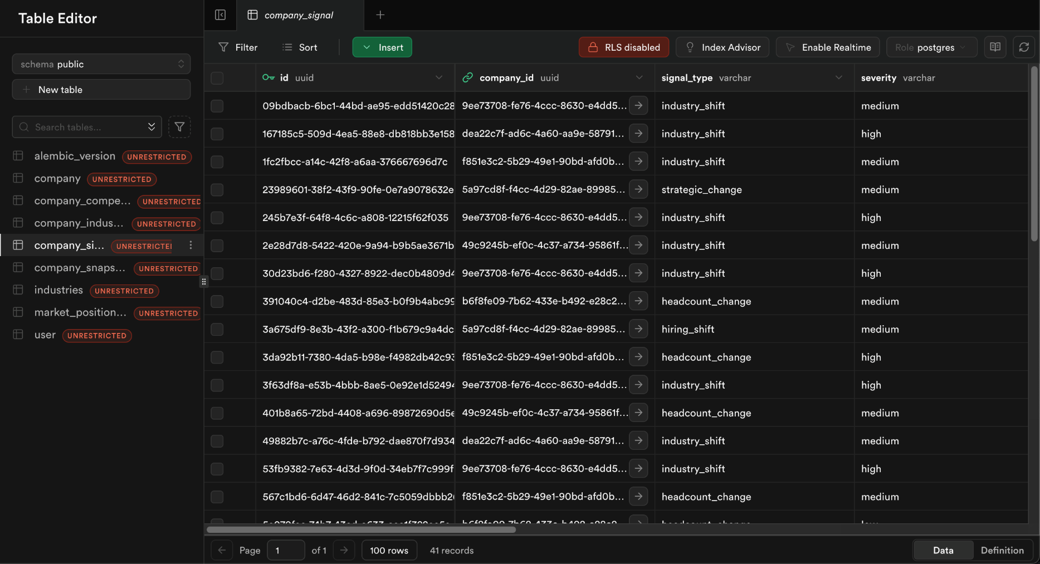
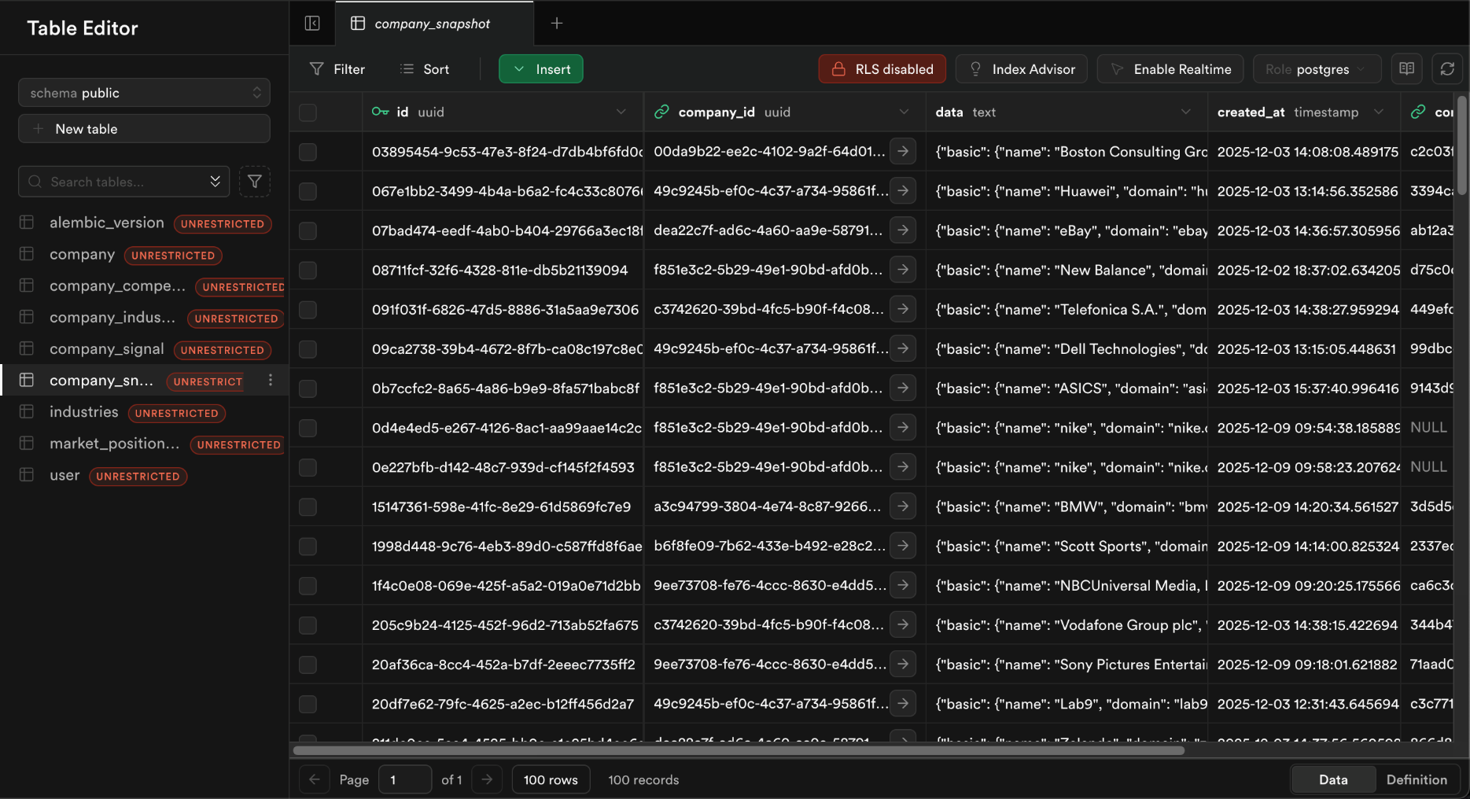

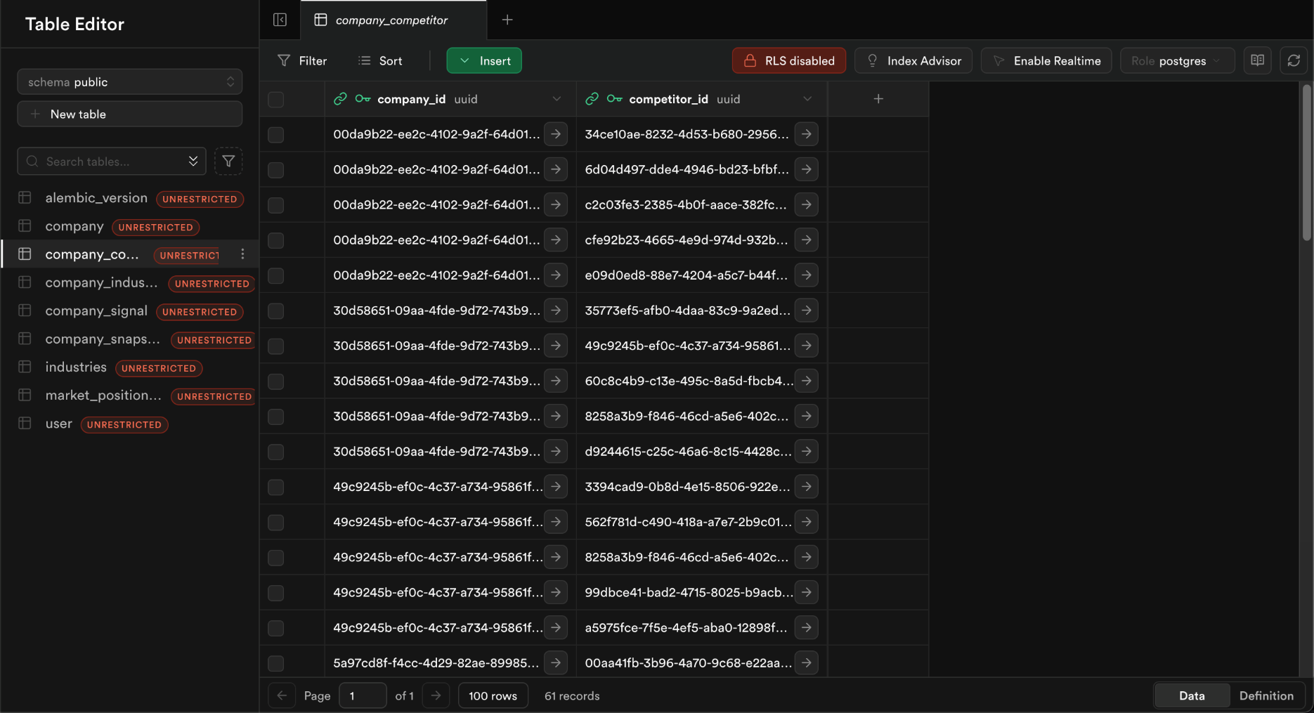
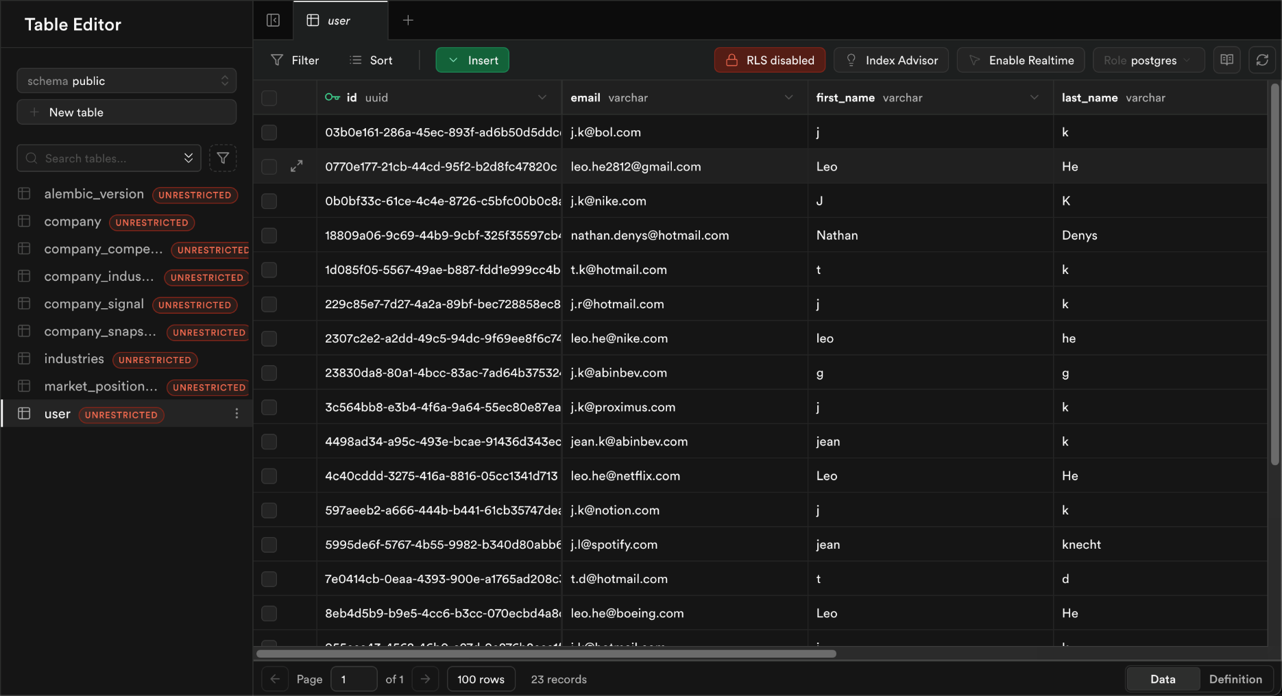
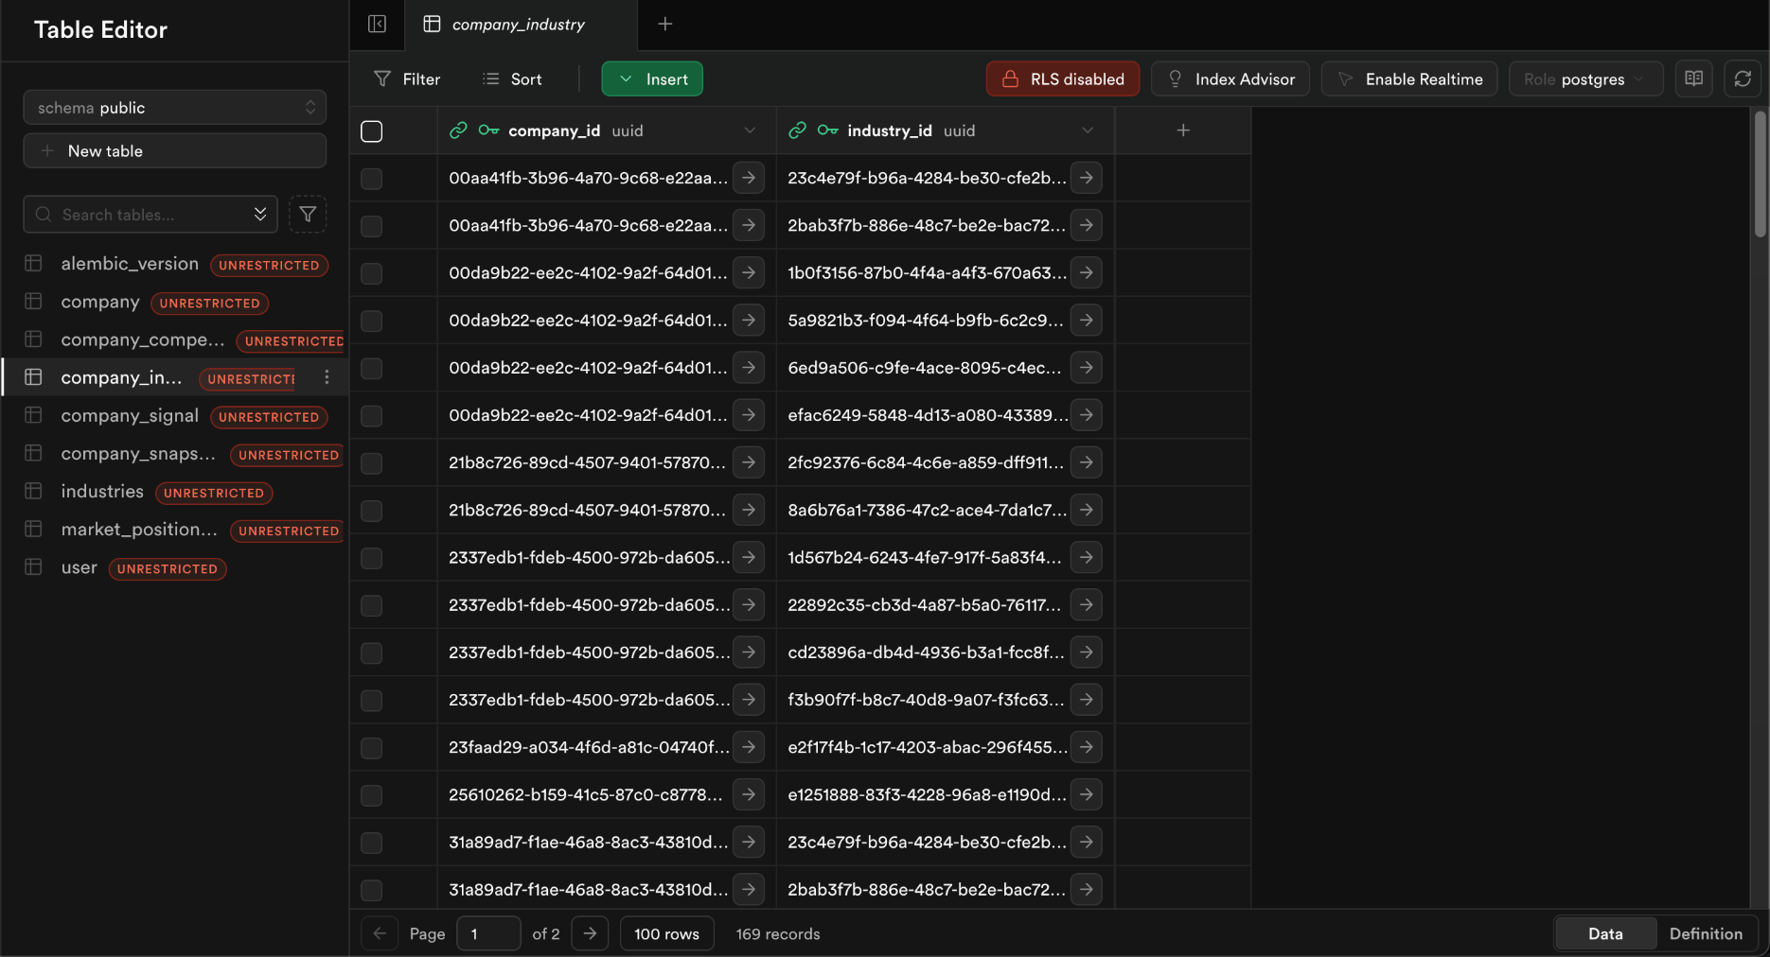
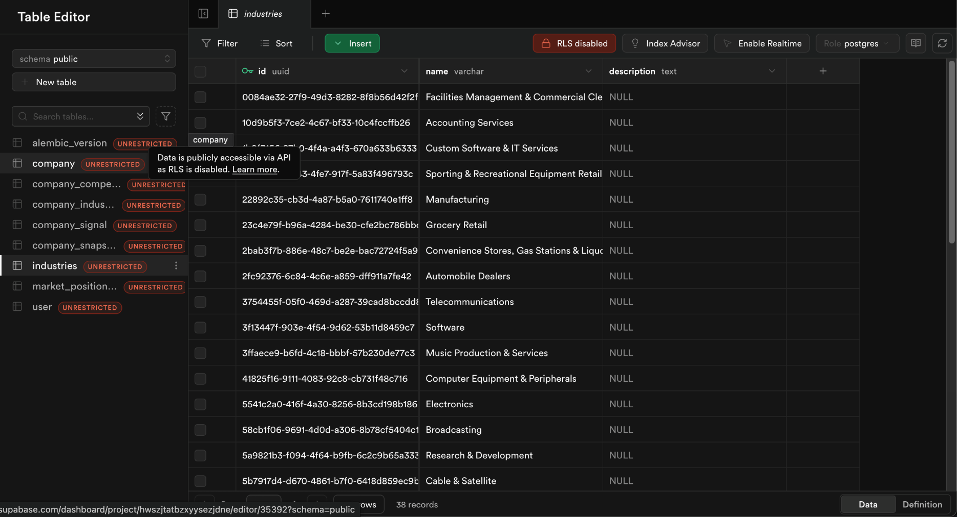
Rival | ERD Database Model
Supabase

Slide 11
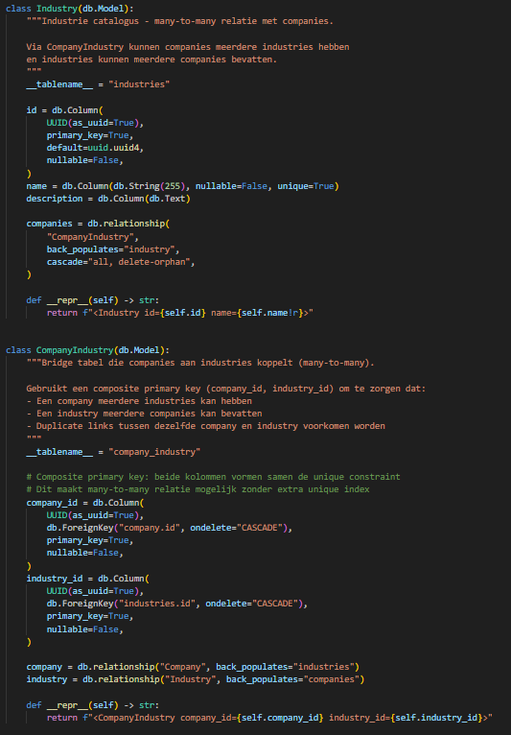
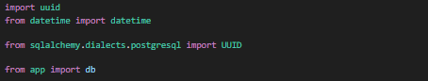
Rival | Creating Python classes to fill in the ERD
Company Industry
Company Competitor
Industries

Slide 12
Rival | Algorithm
Algorithm
How the Rival Algorithm works:
Comparison of meaningful differences between snapshots over time
Loading data from old and new snapshot
Delegating comparisons to field-specific subfunctions
Signals are derived from detected differences, not from raw data

Slide 13
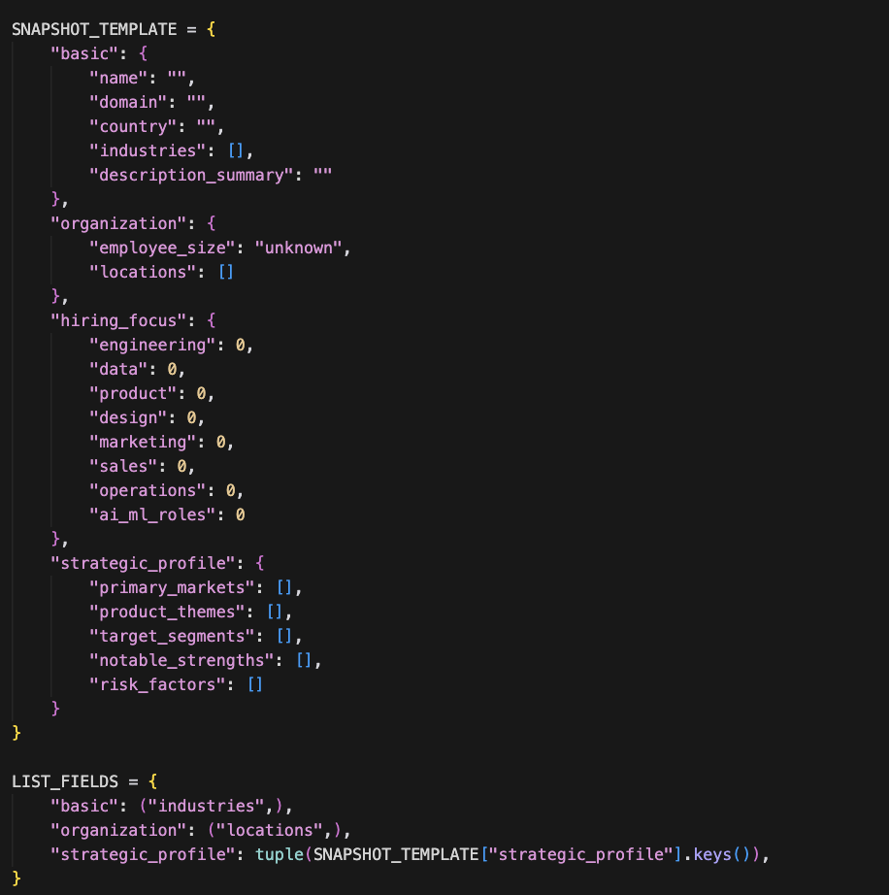
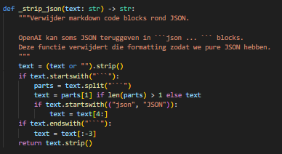
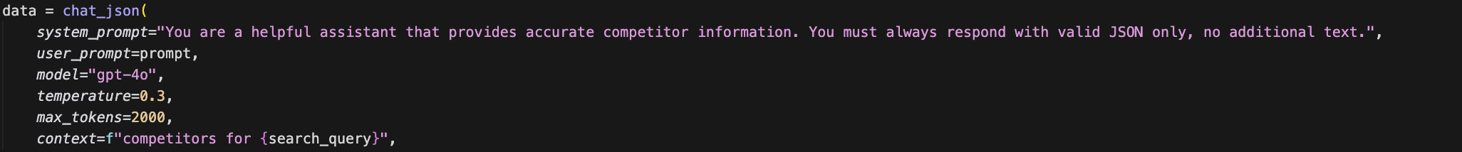
Rival | Company snapshots with JSON
Each company state is stored as a full snapshot in JSON
Snapshot represents one objective, comparable state at a specific moment
Structured fields:
employee size
hiring focus
markets & industries
Foundation for comparing company states over time

Slide 14
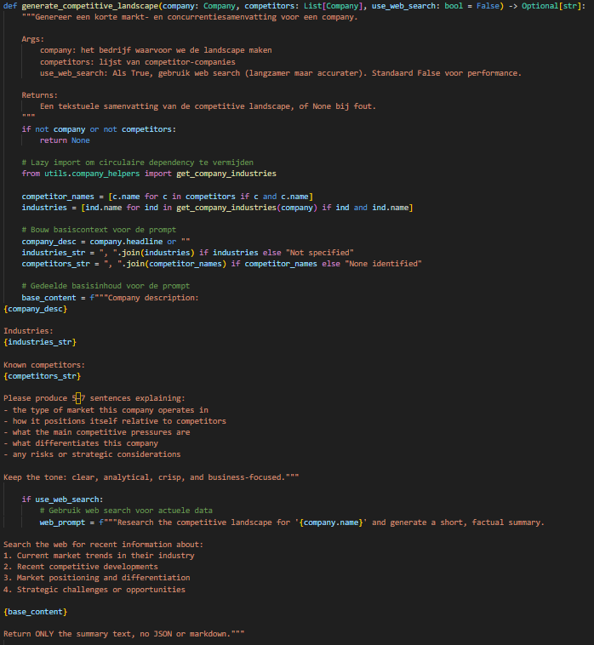
Rival | Summarizing texts without JSON
Free-text summaries have no fixed structure
Output cannot be reliably parsed or compared
No deterministic way to detect changes over time
Suitable for human reading, not for algorithms
Not usable as algorithm input

Slide 15
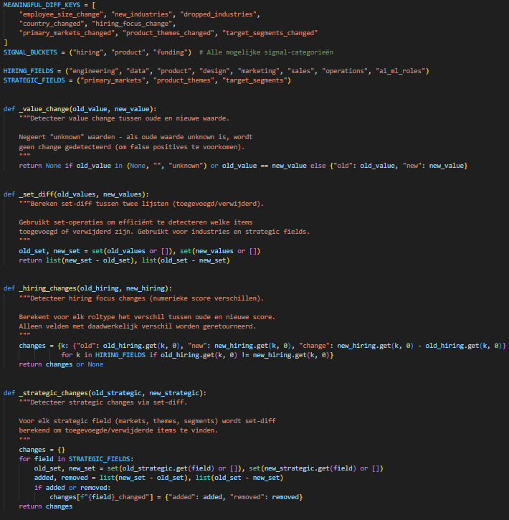
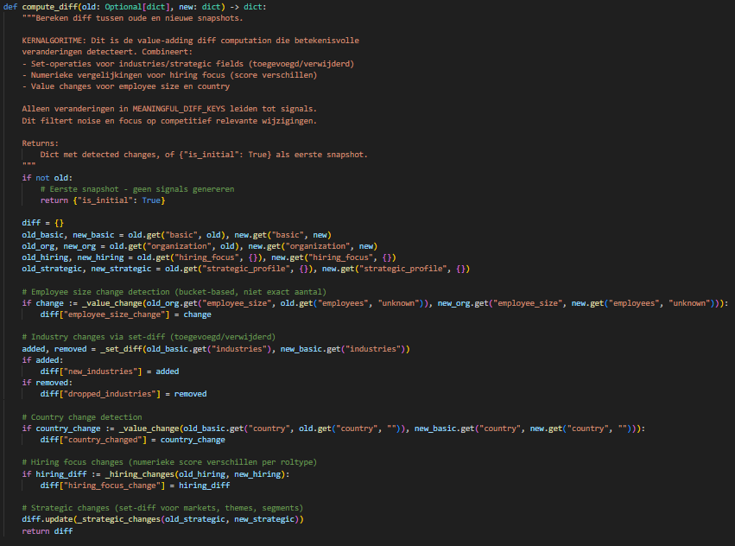
Rival | Meaningful difference detection
Only predefined meaningful fields are compared
Old and new snapshot are loaded side by side
Field-specific logic:
numeric bucket changes
set differences (added / removed)
Textual noise is ignored to avoid false positives
Notes:
derive_change_description ook betrokken
Refresh_competitor_signals main orchestrator ook in algoritme

Slide 16
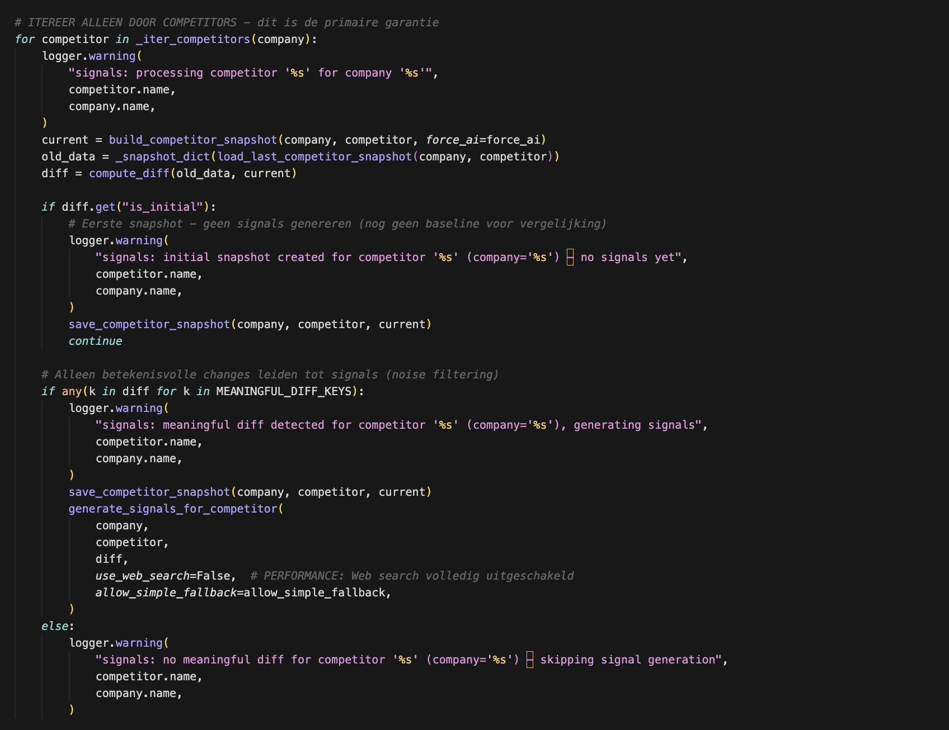
Rival | From Difference to Signal
Signals are created only when a meaningful difference exists
Signal category is enforced by system logic
(hiring / product / funding)
Signals are always competitor-only
Optional context (news) is added after signal creation
Notes:
derive_change_description ook betrokken
Refresh_competitor_signals main orchestrator ook in algoritme

Slide 17
Questions
Jean, Mattis, Leo, Niels & Nathan

Slide 18
Company helpers
Core algorithm
ERD model
Appendix
Jean, Mattis, Leo, Niels & Nathan

Slide 19
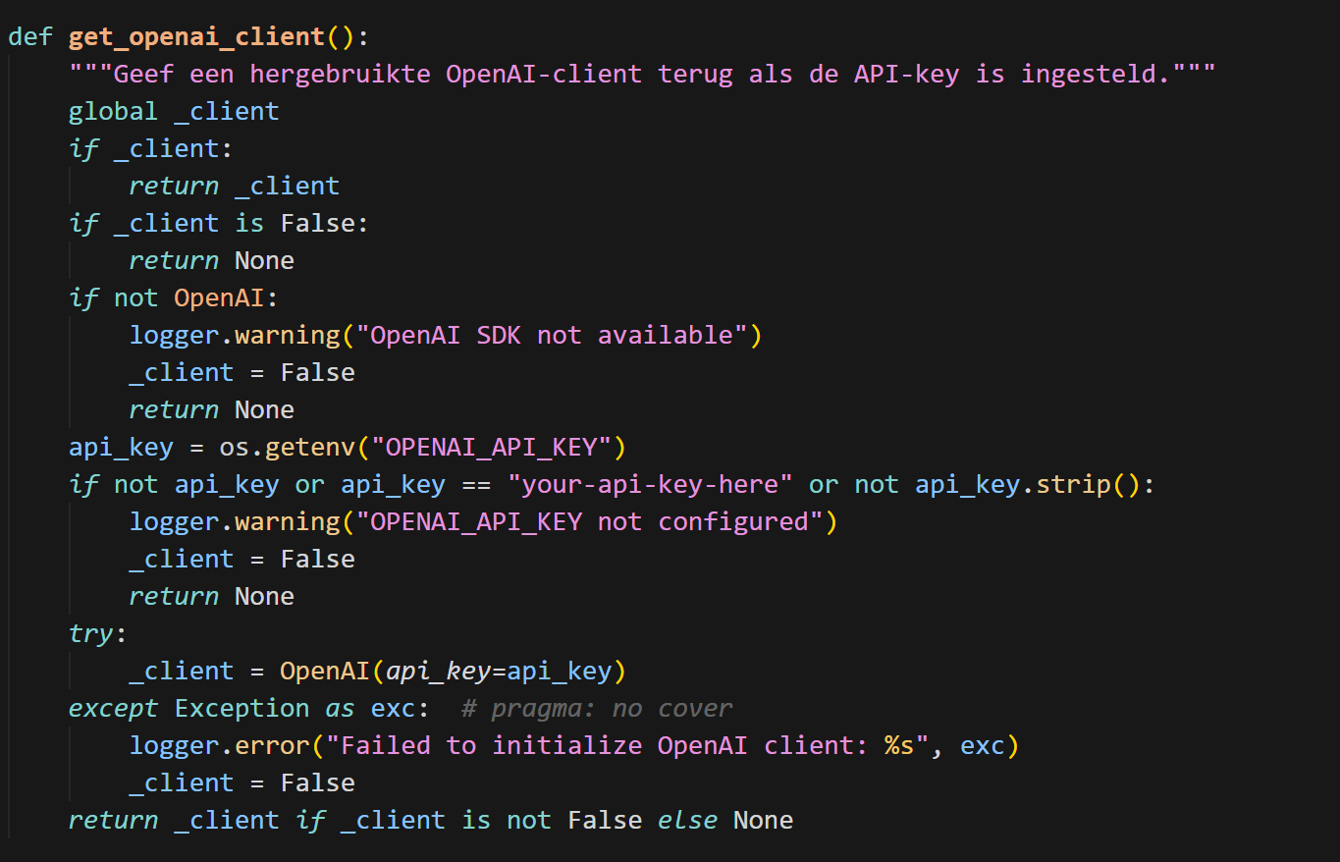
Rival | Company helpers
Appendix
Check if OpenAI key exists

Slide 20
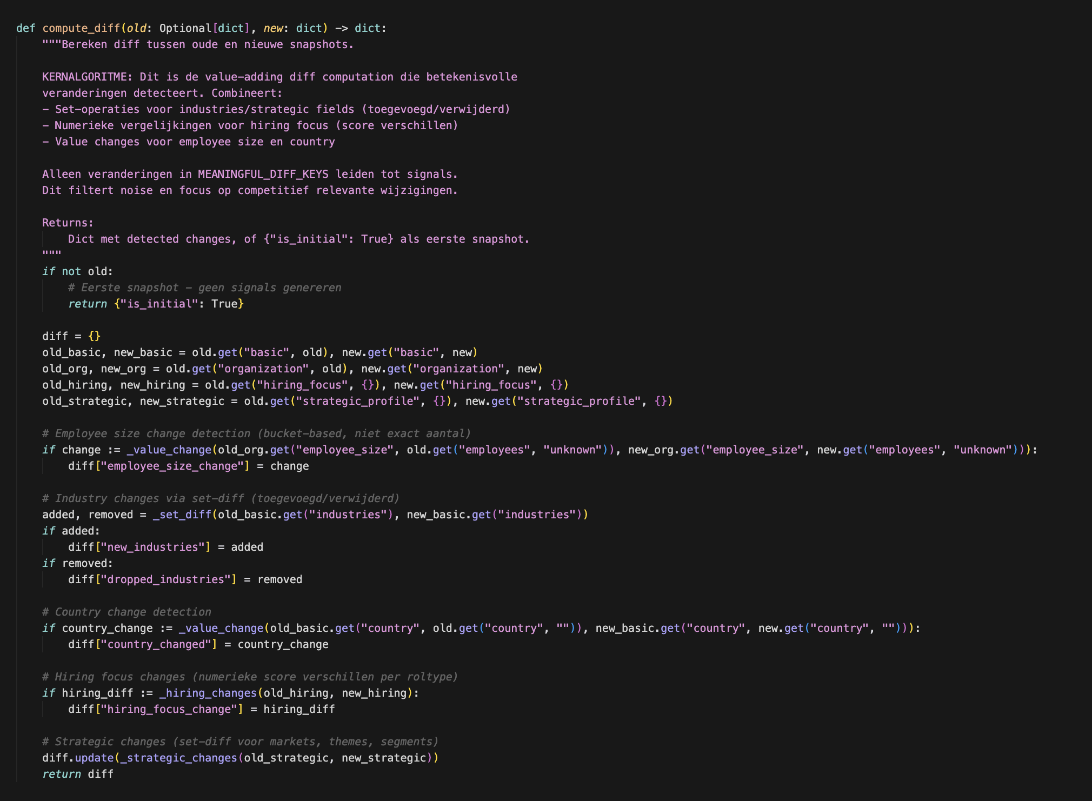
Rival | Core algorithm
Appendix
Check if OpenAI key exists

Slide 21
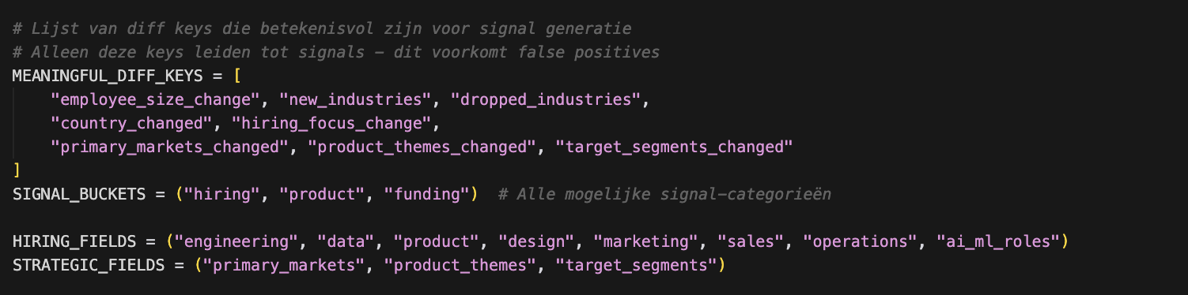
Appendix
Rival | Core algorithm
Appendix

Slide 22
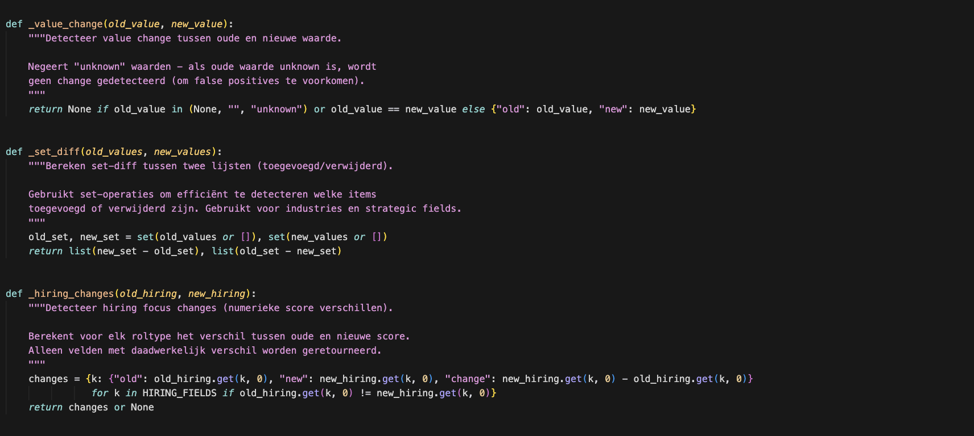
Appendix
Rival | Core algorithm
Appendix
Check if OpenAI key exists

Slide 23
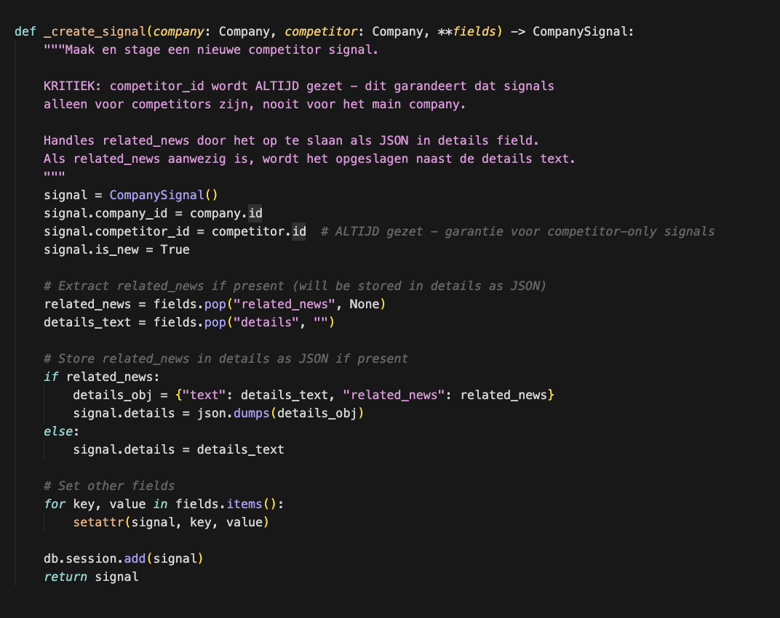
Appendix
Rival | Core algorithm
Appendix

Slide 24
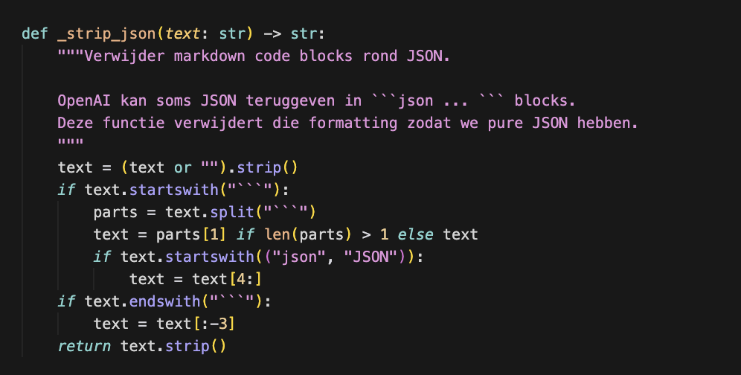
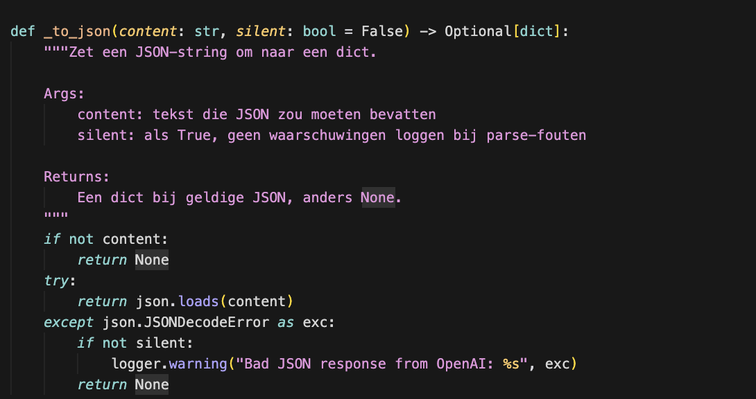
Appendix
Rival | Core algorithm
Appendix

Slide 25
Appendix
Rival | Core algorithm
Appendix
Presentation
Appendix

Slide 26
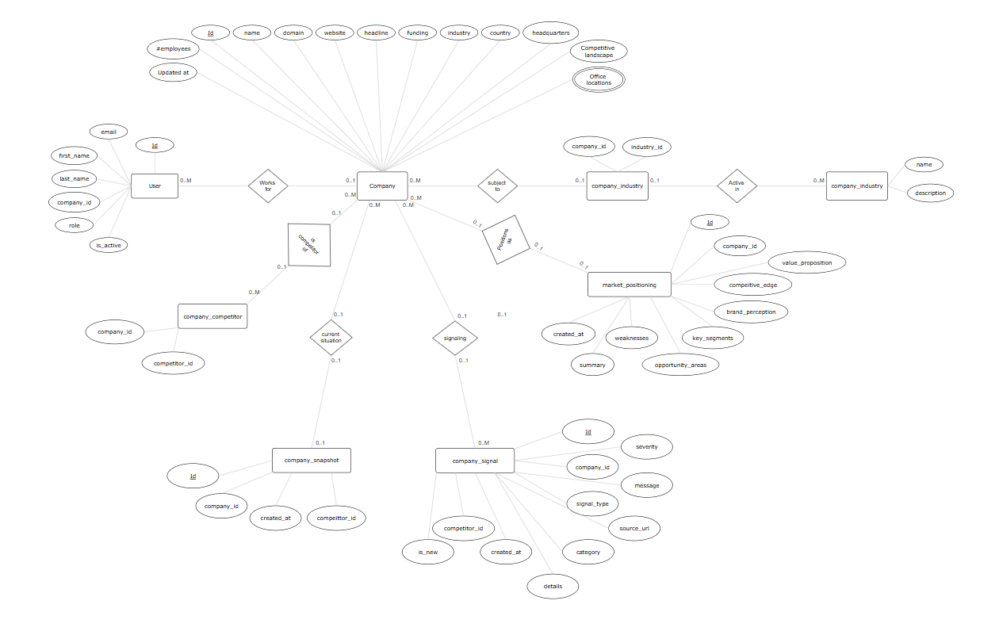
Appendix
Rival | ERD Database model
Appendix
Check if OpenAI key exists

